Slide 1



INDUSTRY PROJECT 3b

Slide 2

TEAM C
Anbei Jiang 18890655
Bipin Suwal 18574078
Zubair Hossain18726967
Asif Ashuvo 18850437
Mohammad Rabbani 18752367

Slide 3






Today’s Outline
Client Introduction/Presentation Purpose
System over View
High-Level System Architecture
System Implementation/Software Demonstration
Agile & Team Maturity
Conclusion

Slide 4
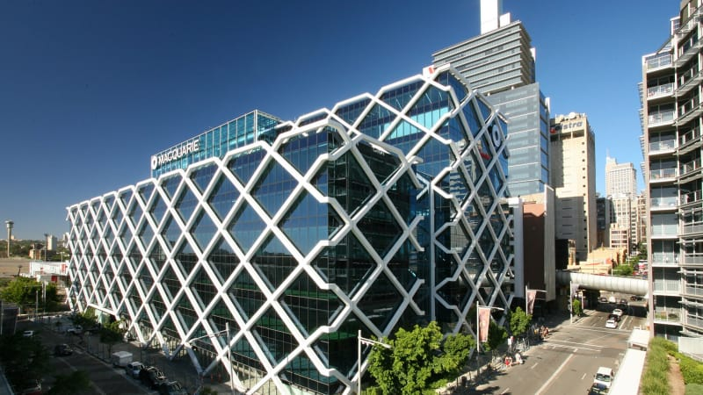
Client Introduction
Our client
Their difficulties
Project goal

Slide 5
Presentation Purpose
Why are we here
What are we going to cover today

Slide 6

System overview
Software Benefits
How the user describes it?
How the programmer wrote it?
How was the project documented?
What the client really needed?
Problems we faced

Slide 7

Problems Faced
Time Management
Learning New Software
New Programming Language
Professionalism

Slide 8

High-Level System Architecture
Hardware components, operating systems, software frameworks, software applications, users

Slide 9








Programs Used
Php
Html
Css
Bootstrap
jQuery
JavaScript
mySQL
JavaScript Libiraries

Slide 10
Structural View
Entities and what are their relationship in our project

Slide 11
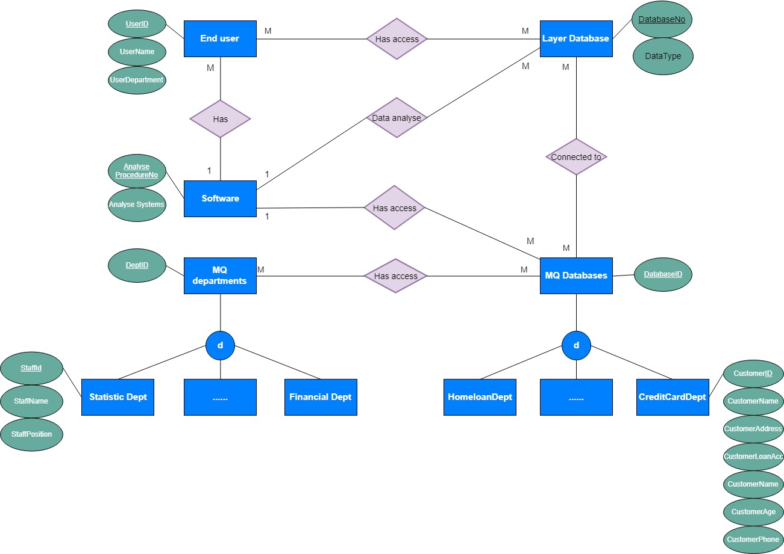

Slide 12
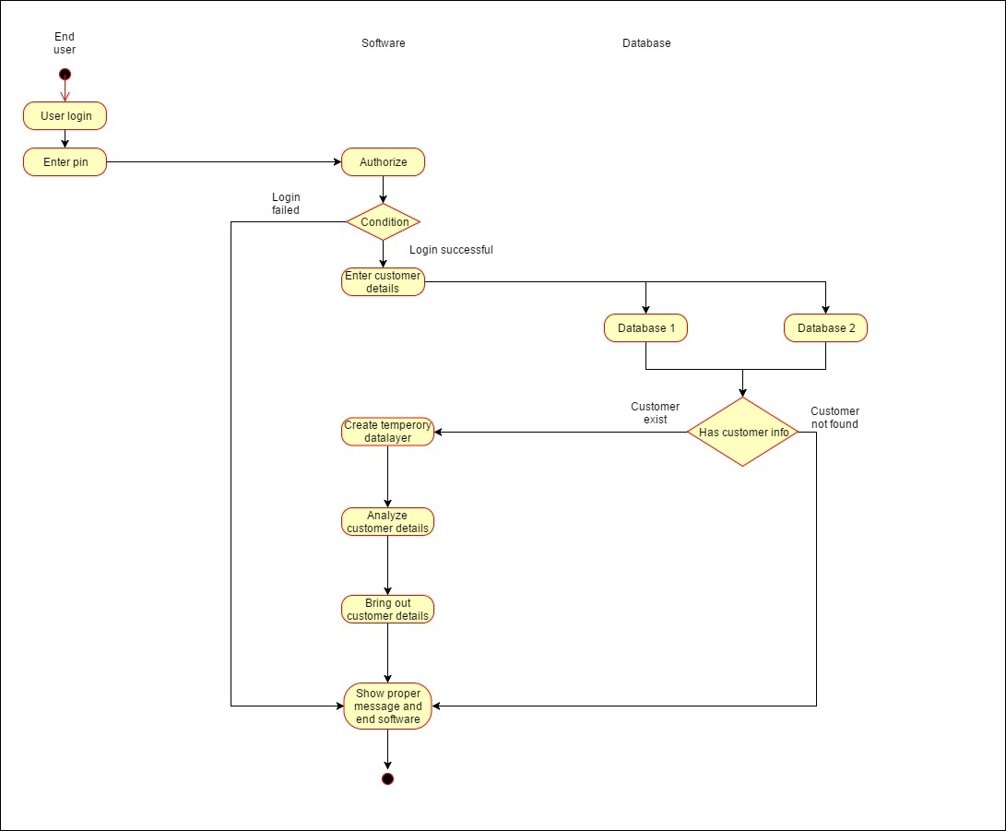

Slide 13
System Implementation/Software Demonstration
Staff/Admin login
View Staff
Search Customer
Customer Info
Add/Delete Staff
Usability Test

Slide 14

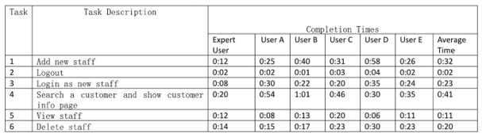
Usability Test

Slide 15
Agile & Team Maturity
Agile methodologies
Group meetings/ Sprints/Retrospective
Old/New comparison

Slide 16
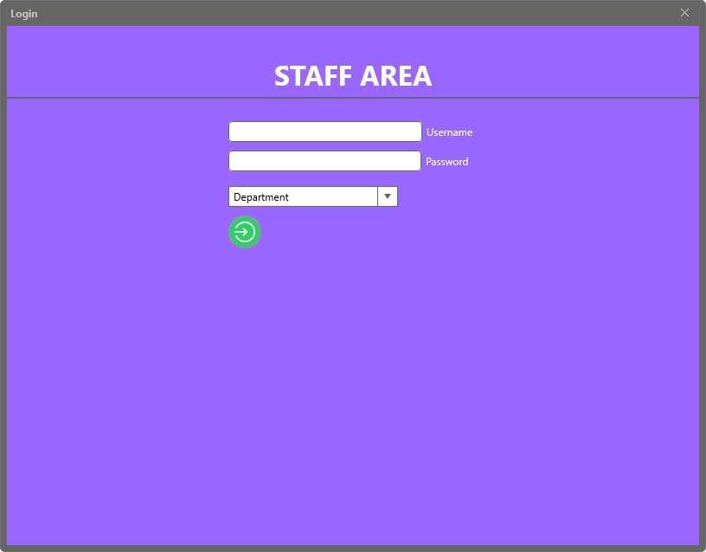
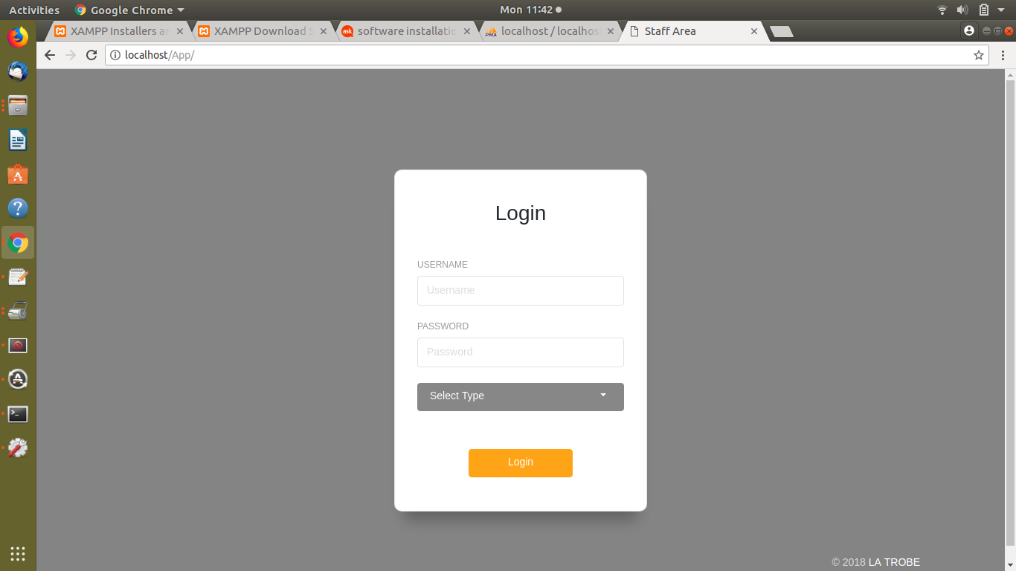
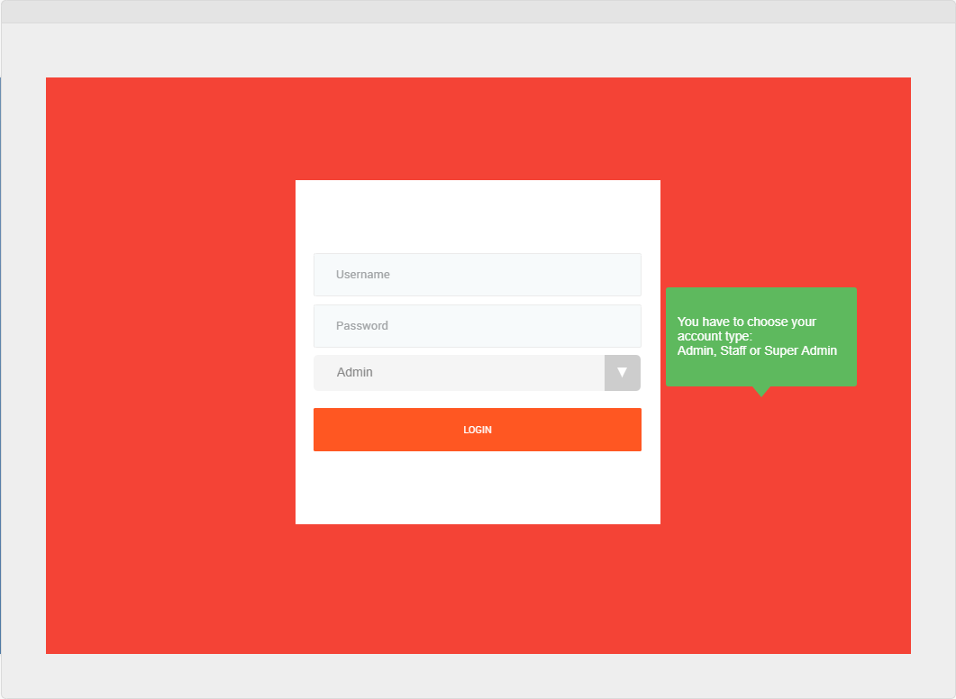

Slide 17
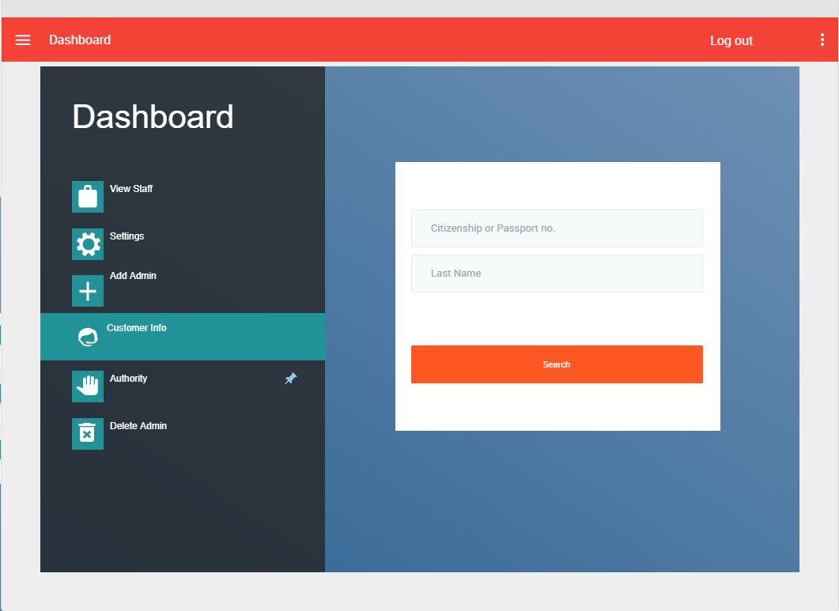
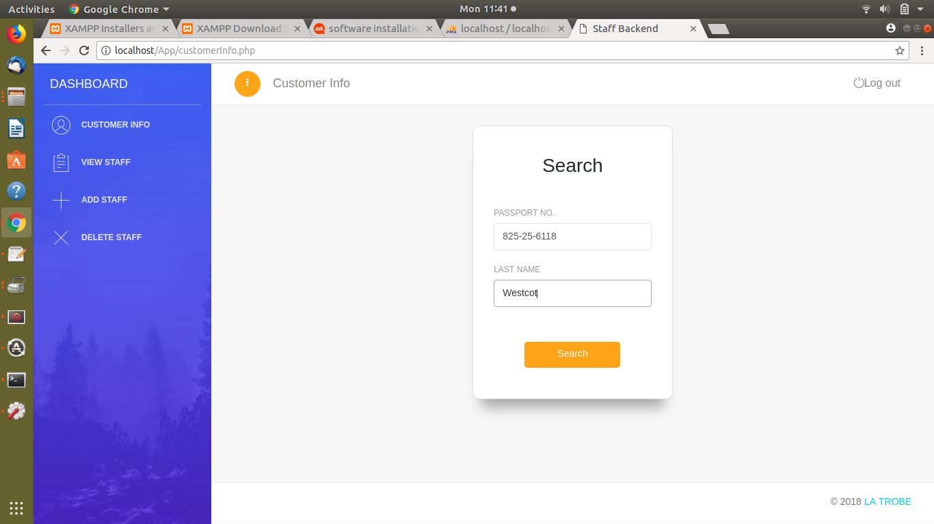

Slide 18
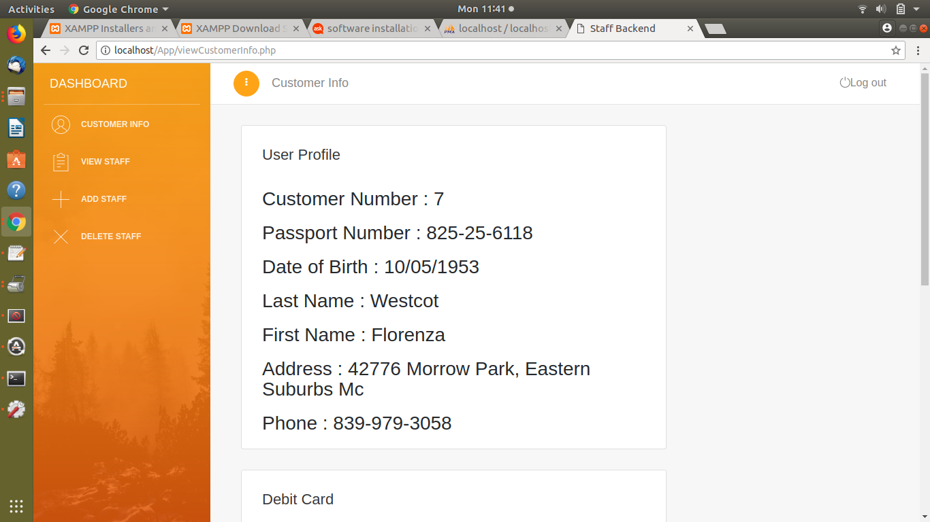
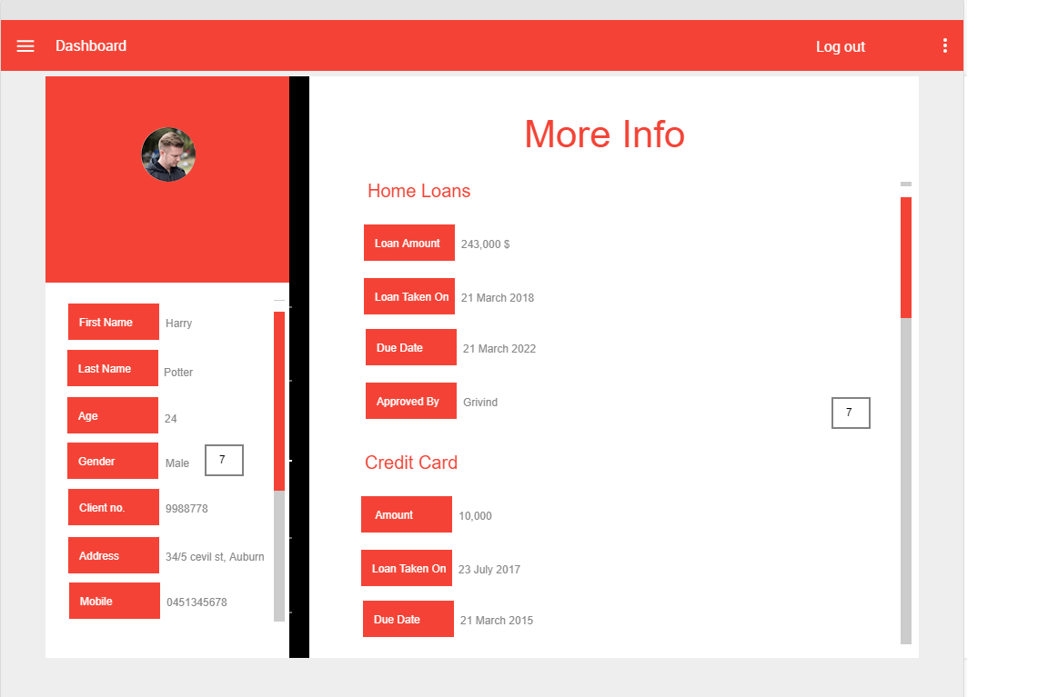
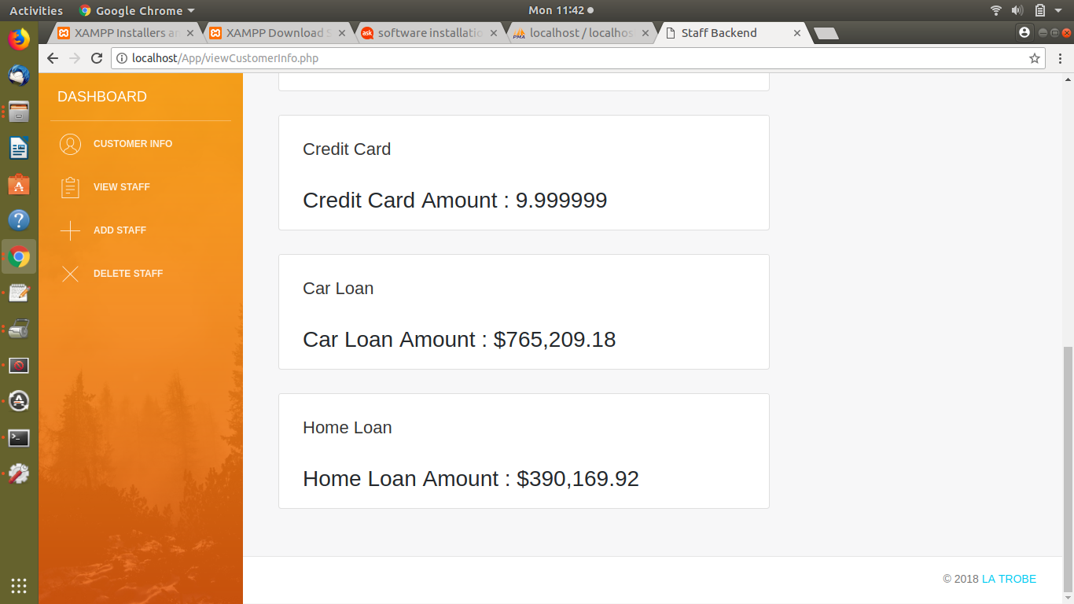

Slide 19

Conclusion
What we have achieved/learned
What to do next(some further improvement on our software)

Slide 20

Thank you for your attention!
We appreciate your questions!

